Slide 1

Goals [NDA]
Understanding of what Azure Linux is.
Feedback since Build: Benefits & Gotchas
How to position Azure Linux in customer conversations.
Resources available to you.
Notes:
Here are the goals for this Live. By the end of the presentation:
[e.g. “you should be able to newestone
Newestone

Slide 2
Overview of Azure Linux
Notes:
[Try to group content into no more than three sections]

Slide 3
What is Azure Linux?
01 Azure Linux Upstream LTS Linux Kernel
Optimized for Hyper-V across cloud and edge, with Azure specific drivers for better performance.
Hardened with secure defaults.
Supports multiple silicon architectures used in Azure. E.g. x86_64, ARM64
Azure Linux Infra & Services
04
Composable Framework
03
Azure Linux Core
02
02 Azure Linux Core
~10,000 packages with fidelity (via RPM) across Amazon Linux, RHEL, and CentOS.
Small footprint. ~ 67MB container base image and ~ 380MB core image.
01
Microsoft Linux Kernel
03 Composable Framework
Package-based or image-based update mechanisms for atomic servicing and rollback.
04 Azure Linux Infra & Services
Built from scratch to ensure supply chain security.
Critical CVEs patches available within 72 hours

Slide 4
Azure Linux on Azure Kubernetes Service
Azure managed control plane
User
App/workload definition
Schedule pods over private tunnel
container- runtime
container- runtime
Customer nodepools running Azure Linux as the OS
All the benefits of AKS
Available worldwide wherever AKS is available.
All Azure extensions and add-ons tested.
New features will be supported on existing distros plus Azure Linux.
plus, the benefits of Azure Linux
Slimmer image (~hundred fewer packages) resulting in better performance and security.
Robust testing.
One vendor to support the full AKS stack.
Microsoft infrastructure scanning and patching security patches.

Slide 5
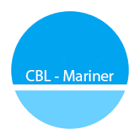

Release Cadence
Image Validation and Performance: Thorough validation and performance testing in Azure environments part of internal gates.
Packages validation: Packages validated in Azure. Faulty Packages (moby-containerd etc) gets blocked as AKS E2E tests are core internal validation gates.
Agent and E2E validation: Agents teams validate Azure Linux as default supported image (in-progress). AKS planning to perform additional scale and stress tests to cover the complex AKS scenarios.
Release Cadence: Azure Linux performs upgrades monthly. AKS builds new images weekly from published packages updates.
Validation by Azure Linux Team
Validation by AKS Team
Azure Linux Build
Azure Linux & AKS test suites
Published in Marketplace
AKS Image Builder
AKS E2E tests
AKS release
Azure Linux Package updates
PMC
Enters AKS’ test suite

Slide 6





















Work how you want with growing partner ecosystem
Development | DevOps | Monitoring | Networking | Security
ARM
Bicep
All Azure agents and extensions supported on AKS

Slide 7
Feedback since GA Announcement
Notes:
[Try to group content into no more than three sections]

Slide 8
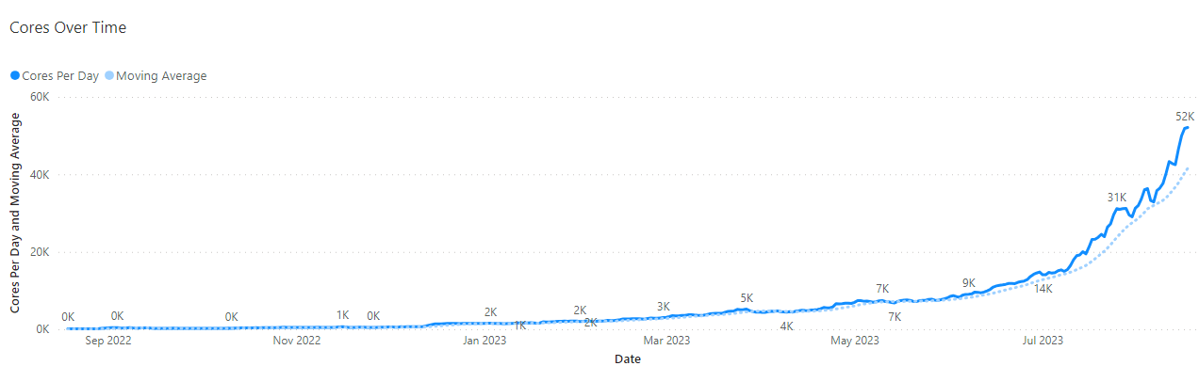


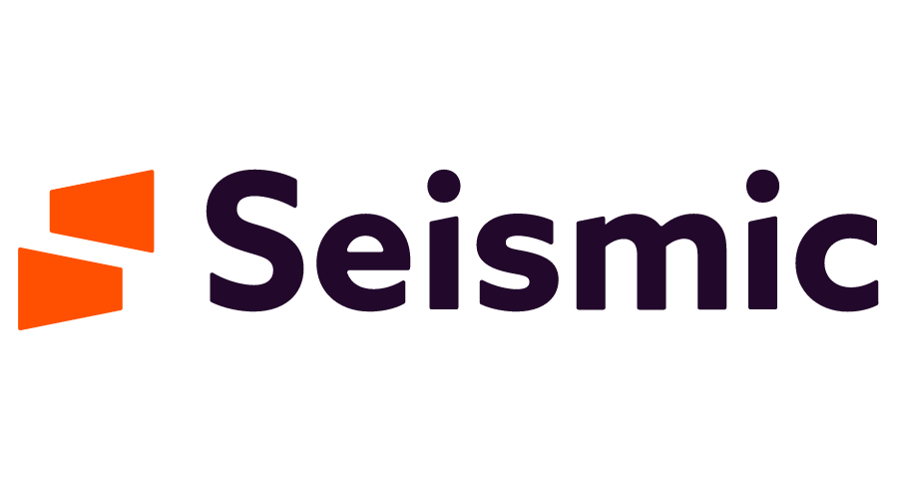
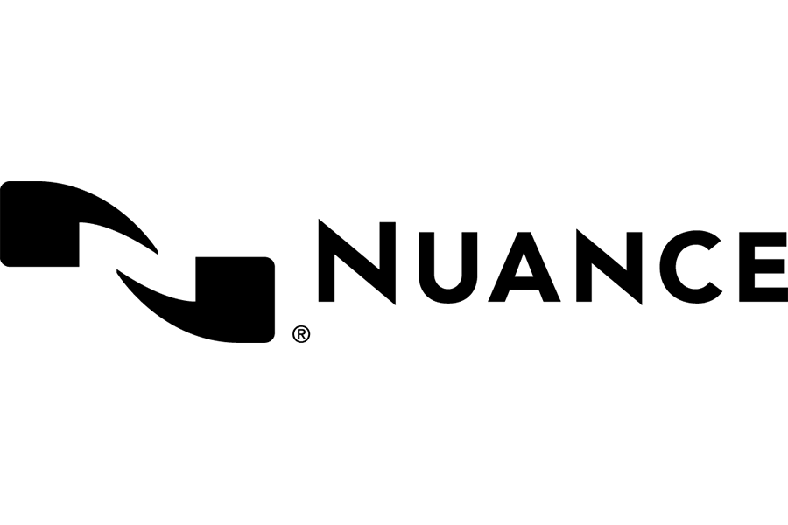
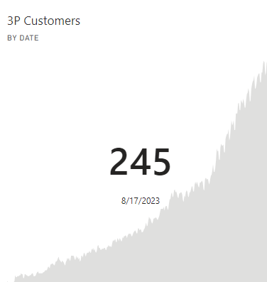





Azure Linux Third Party Customers
Customer core adoption since GA
Customers rapidly adopting Azure Linux
Customers prototyping (200+cores)
Customer count of Azure Linux with AKS

Slide 9
Customer Insights and Benefits
S500s gravitating towards Azure Linux.
Performance improvements makes their operations easier.
“They are running workloads nprod and prod with great feedback, that azure Linux is more faster to response kubectl command , scaling and others test made” – Grupo Santander.
One support channel: Customers like Infosys who have had troubles have appreciated having one line of support with both AKS and Azure Linux.
cgroupsv2 rollout with Ubuntu 22.04 has caused lots of customer pain and customers are moving to Azure Linux (which has cgroupsv1).
Robustness: Ad-hoc package upgrades continue to be a challenge. Ie. Ubuntu’s Kernel upgrade from 5.15 to 6.2 caused Azure CNI failures

Slide 10
Common pitfalls and gotchas
Azure Linux has three OS SKUs: cbl-mariner, mariner, AzureLinux. Customers need to use AzureLinux.
Daemon Sets. Customers like InMobi & UBS have Daemon Sets that take a dependency on the node OS. This requires migration of scripts.
Recommendation: Customize the node configuration for Azure Kubernetes Service (AKS) node pools - Azure Kubernetes Service | Microsoft Learn
Daemon Sets installing custom CAs.
Recommendation: Custom certificate authority (CA) in Azure Kubernetes Service (AKS) (preview) - Azure Kubernetes Service | Microsoft Learn
Azure Linux only supports the following GPUs: NVIDIA T4s, NVIDIA V100s.
Only support node-image and None for nodeOSUpgradeChannel.

Slide 11
Positioning with customers and how you can help
Notes:
[Try to group content into no more than three sections]

Slide 12
Dos and don’ts
Do | Don’t
Position Azure Linux as the preferred Microsoft Linux distribution for AKS that is available in General Availability. | Push it on customers who have a business need for other Linux distributions.
Talk about the value propositions of Azure Linux. | Compare Azure Linux against Ubuntu, Red Hat unless prompted by a customer.
Reach out to the Azure Linux or AKS product groups for support.

Slide 13
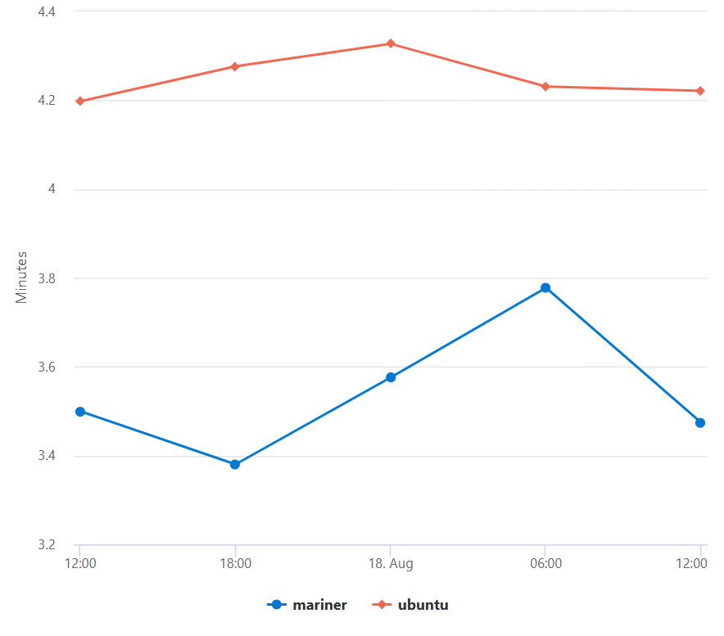
Performance
Average cluster create times
Azure Linux consumes limited disk and memory resources​
Only 500 packages compared to 700 on Ubuntu.
Up to 5GB less disk space consumed.
Customers have noticed
30% faster cluster upgrade times
40% faster cluster creation times
3 seconds faster boot time
Notes:
Fastest cluster operations time on AKS (create, upgrade, node start up, pod start up).
We run rigorous build time performance tests, synthetic production tests and monitor production performance.

Slide 14
Security
Hardening: Secure-by-default principle.
CVEs: Early notifications for most CVEs – faster fleet patching.
Audits: Independent security audits to ensure build system and tooling security.
Lightweight: Reduced packages = reduced attack surface.
Vulnerability Scanning: Qualys, Trivy, Tenable, Anchore, Prisma Cloud.
Compliance: Pass all Level 1 CIS benchmarks.
Notes:
Hardening: Built with an emphasis on security and follows the secure-by-default principle , including hardened kernel and hardened flags
CVEs: Early notifications for most CVEs allow time to evaluate and potentially notify customers of issues or required changes – faster fleet patching
Independent security audit run to ensure build system and tooling security
Reduced amount of packages reduces the attack surface
Qualys, Trivy, Tenable, Anchore, Prisma Cloud Qualys
Vulnerability scanning
Improved security around ebpf. We disable the bpf interpreter and unprivileged bpfs
Compliance: CIS and FIPS image, automated STIG assessments are completed for each release

Slide 15
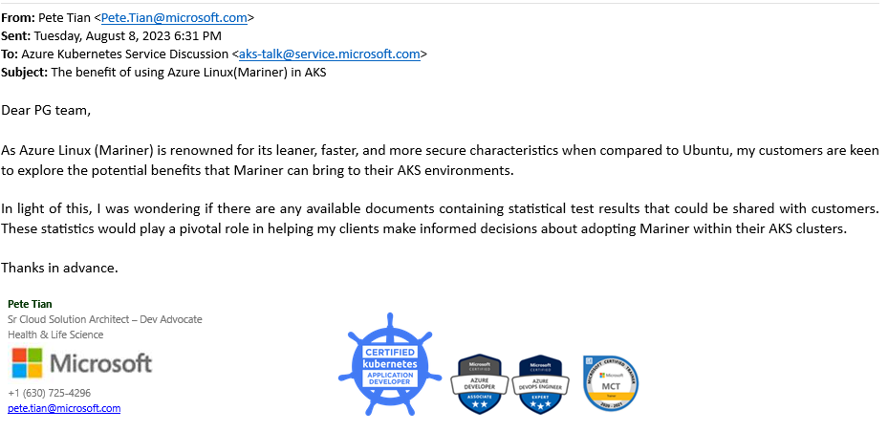
How you can help
Include Azure Linux in customer conversations, demos, workshops that you may do.
Given it will become the default OS SKU, we want to move customers where appropriate.
Customer platform teams are easy to sign-off on Azure Linux but app teams slower.
Recommendation: Azure Linux for AKS.pdf

Slide 16
Roadmap
Notes:
[Try to group content into no more than three sections]

Slide 17
Roadmap (dates subject to change)
Feature | Description | Timeline
Azure Linux is default OS SKU | All new clusters will default to Azure Linux 2.0 instead of Ubuntu. | CY2024
Containers | Azure Linux releases containers for external use | ~6 months
Azure Linux 3.0 | Development and release of Azure Linux 3.0, the next major version | ~8 months
WSL | Release a public WSL image | TBD
VMs | Azure Linux releases VMs for external use | TBD

Slide 18
Resources
Resource | Description | Link
GA docs for Azure Linux | This will be the public docs for Azure Linux. Will be publicly available at Build. | https://aka.ms/azure-linux-docs
Azure Linux Public GitHub repo | This repository contains the toolchain and SPEC files for all the packages that make up the distro. | https://github.com/microsoft/CBL-Mariner
Azure Linux AKS TSG | Troubleshooting guide containing how to resolve most common customer reported issues during preview. | https://learn.microsoft.com/en-us/troubleshoot/azure/azure-kubernetes/troubleshoot-common-mariner-aks
How to deploy Azure Linux on AKS today | Existing public documentation as part of AKS docs. | https://aka.ms/use-aks-mariner
Azure Linux Teams Channel | Q&A with internal community and product team | Link AKS Mariner QA DG General Mariner QA DG
This presentation |  | AzureLinux_LevelUp_August2023.pptx
Performance | Performance Analysis of Ubuntu vs. Azure Linux | AKS Container Host Performance - Power BI
Two-pager outlining benefits of Azure Linux | Goes over benefits of Azure Linux that you can share with customers. | Azure Linux for AKS.pdf
Notes:
As far as resources go, our documentation on engineering hub is definitely the best place to get started. If you run into questions or need help, we've got a very responsive community on our teams channel with over 600 members. Joining the MarinerAnnouncements DL is the best way to keep in touch about Azure Linux updates

Slide 19
Questions?

